Slide 1


ML Robustness
Gagandeep Singh
VMware Research and UIUC

Slide 2
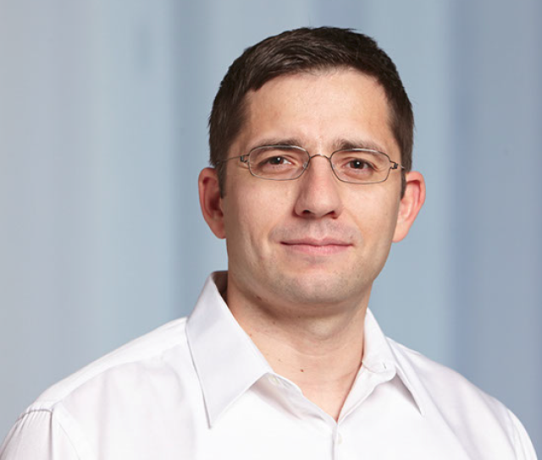
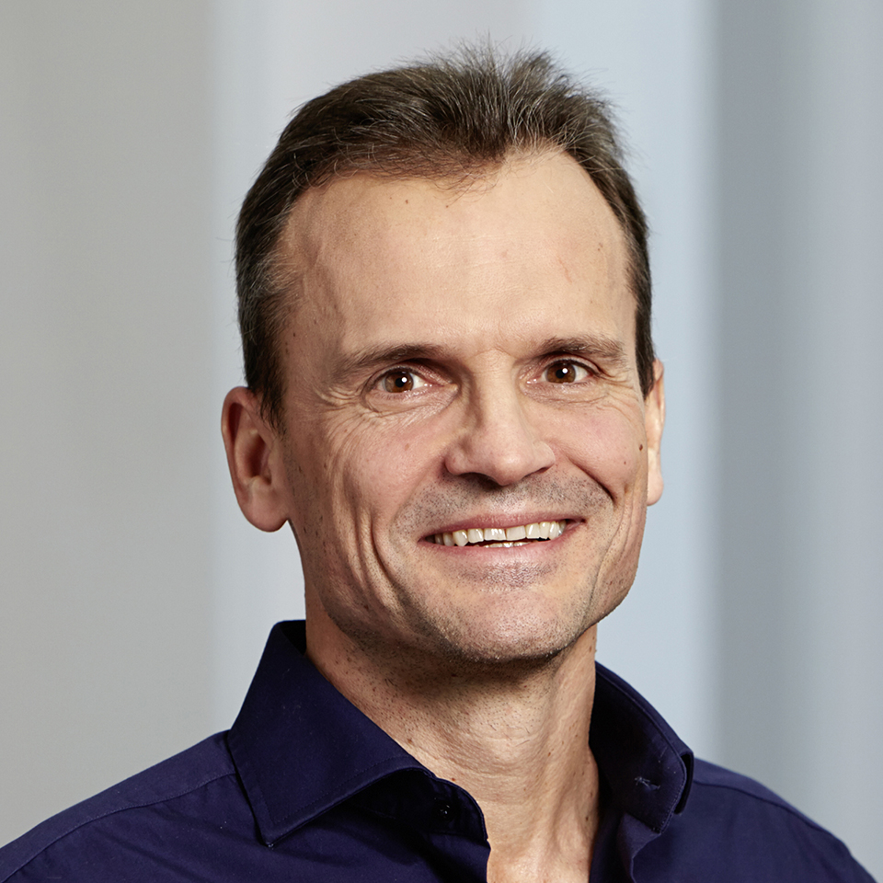
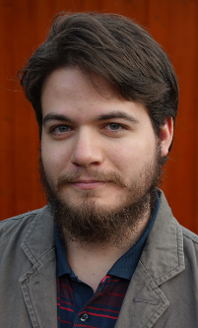
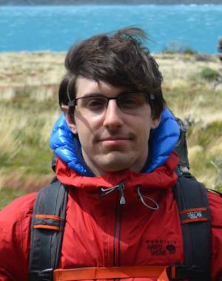
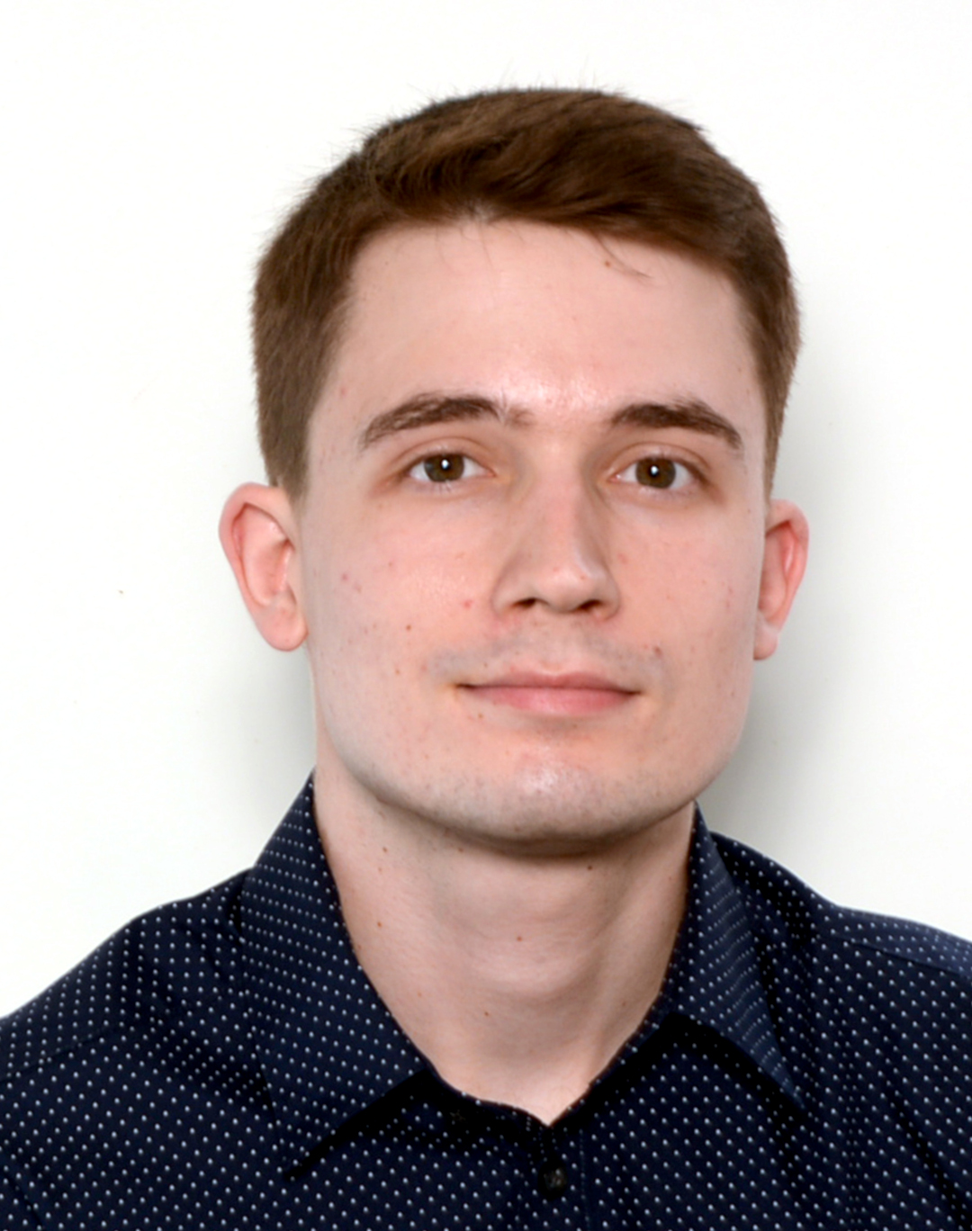

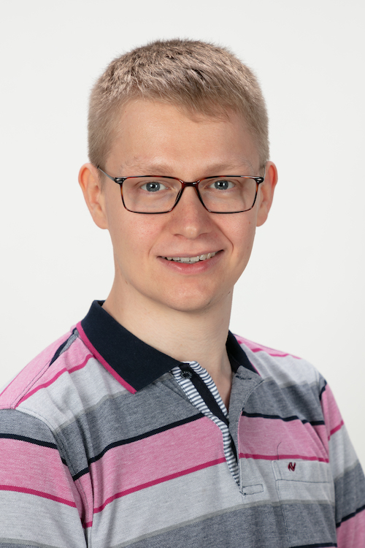
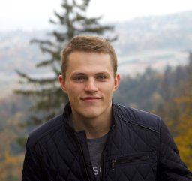
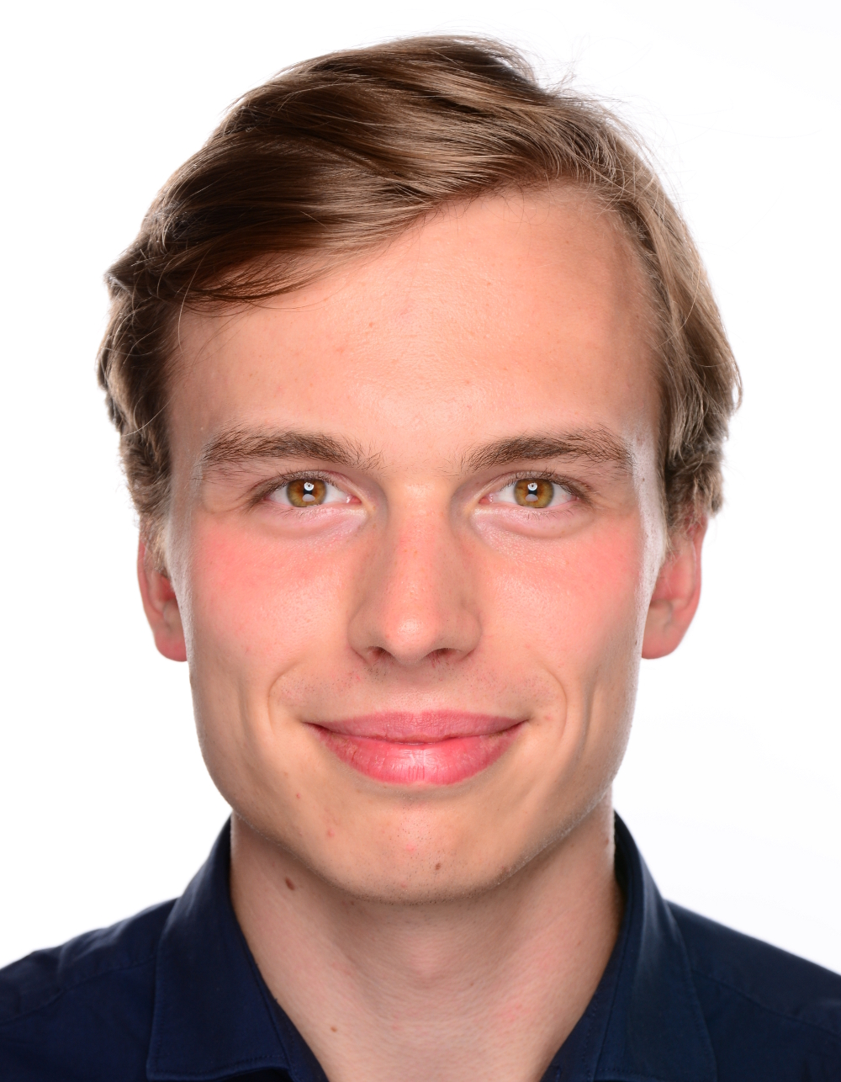
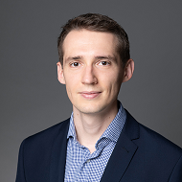
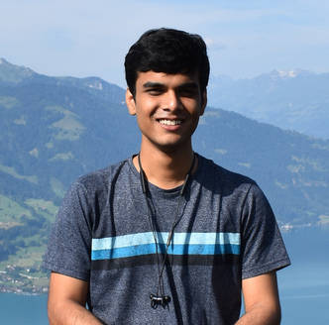
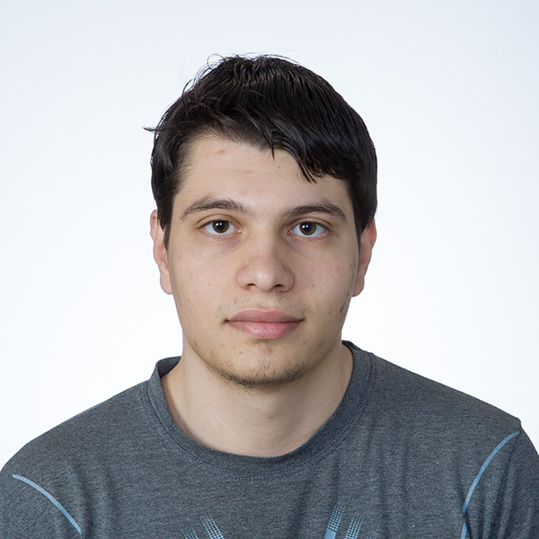
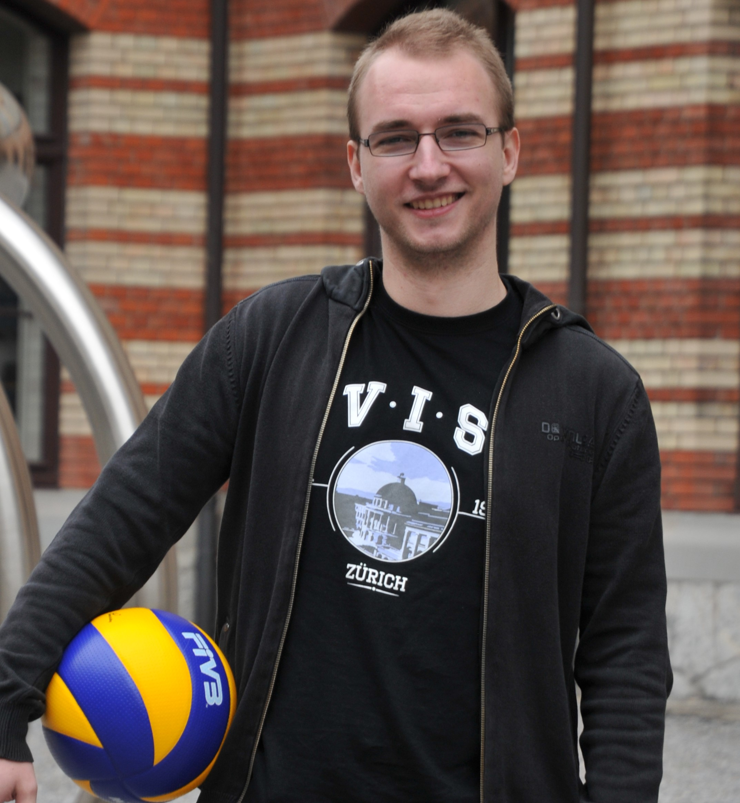
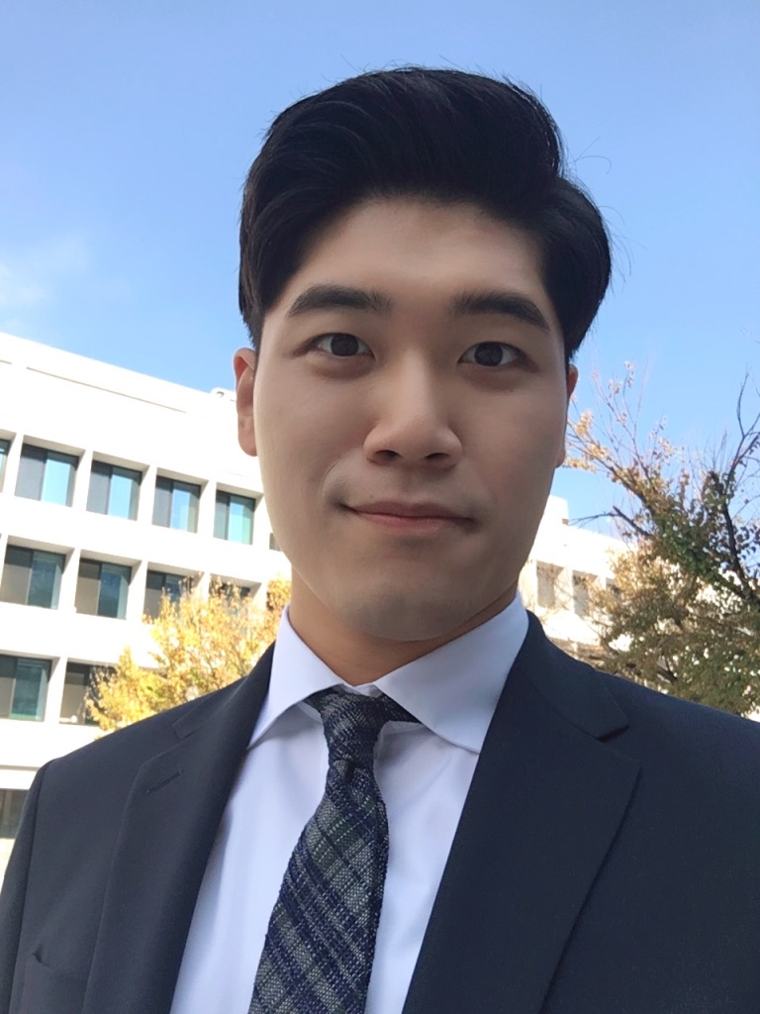

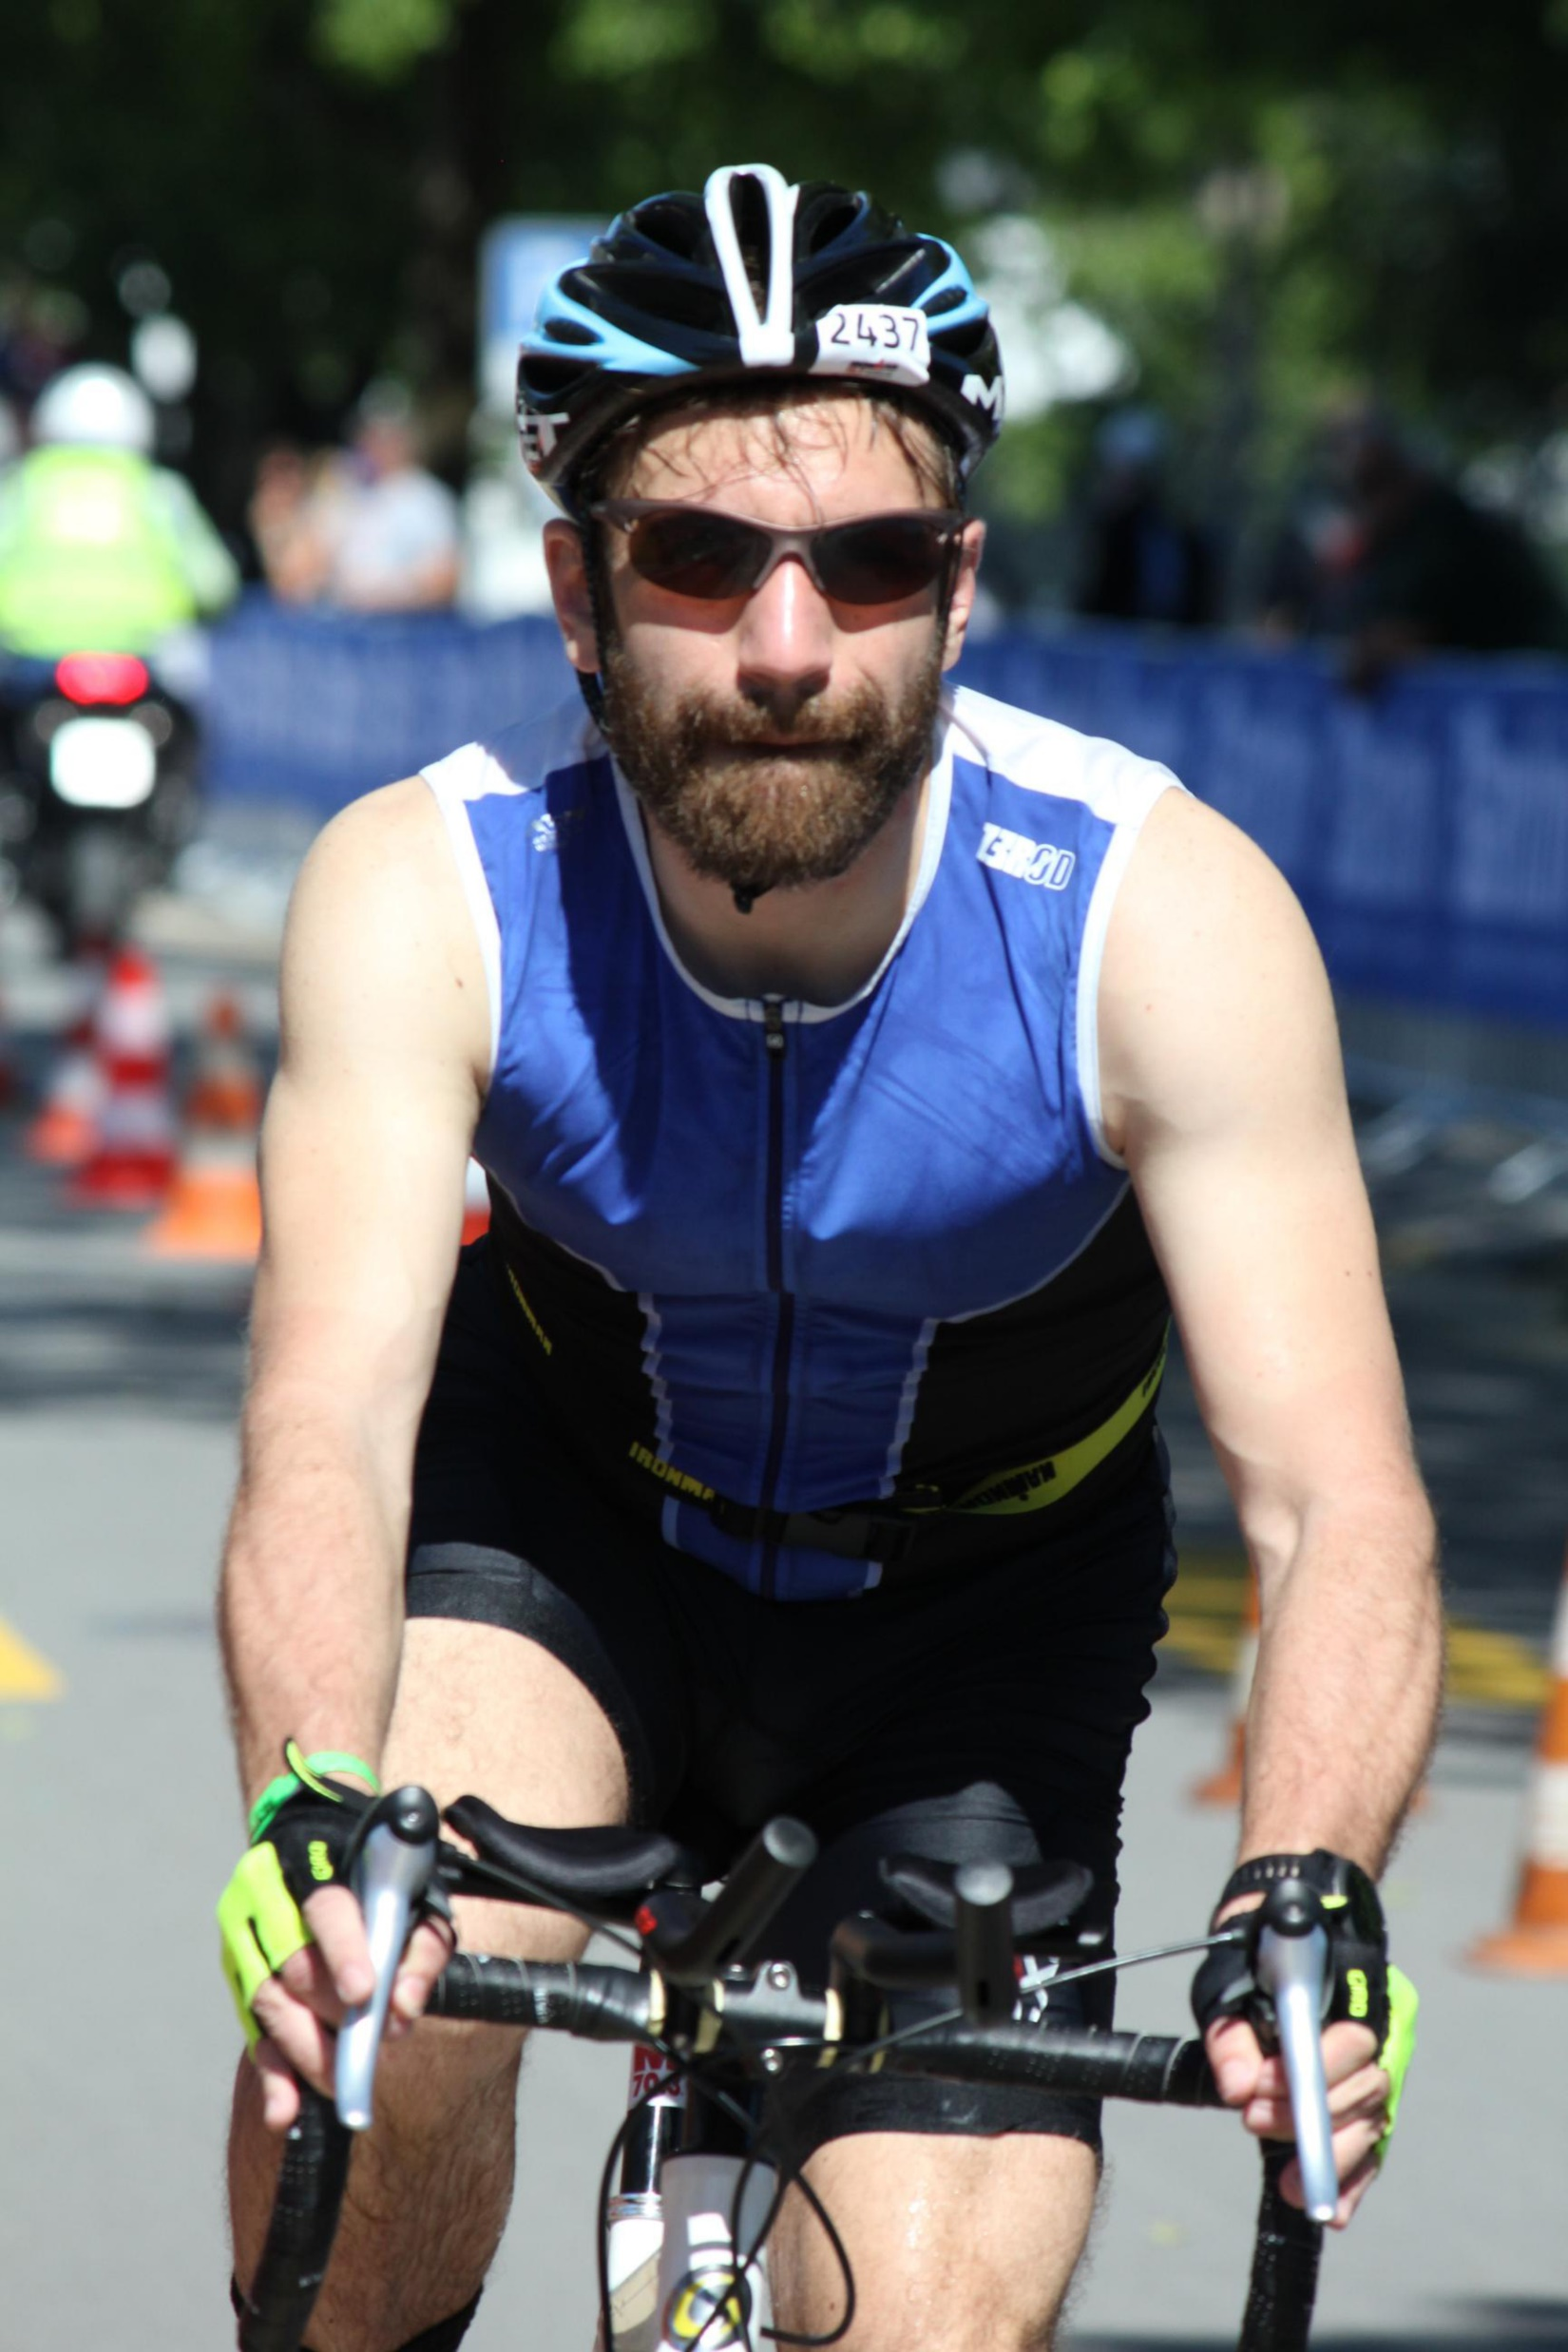
Based on work with
Martin Vechev
Markus Püschel
Timon Gehr
Matthew Mirman
Mislav Balunovic
Maximilian Baader
Marc Fischer
Gleb Makarchuk
Mark Müller
Andrei Dan
Rupanshu Ganvir
Dimitar Dimitrov
Jonathan Maurer
Wonryong Ryou
Raphael Dang-Nhu
Francois Serre
and many others…….

Slide 3
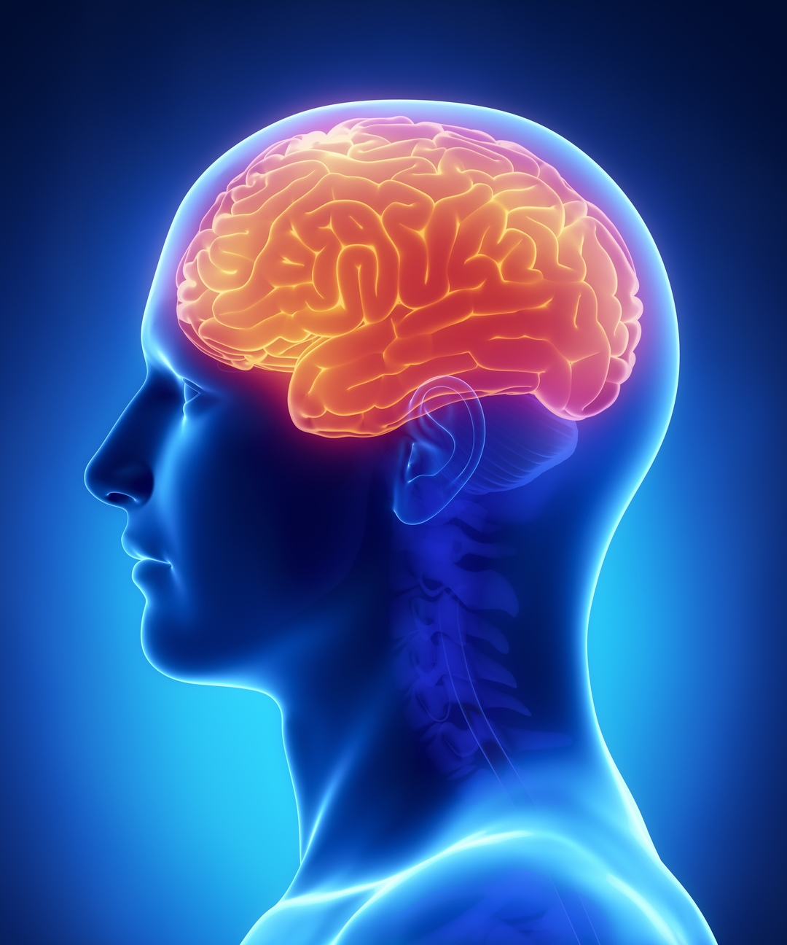
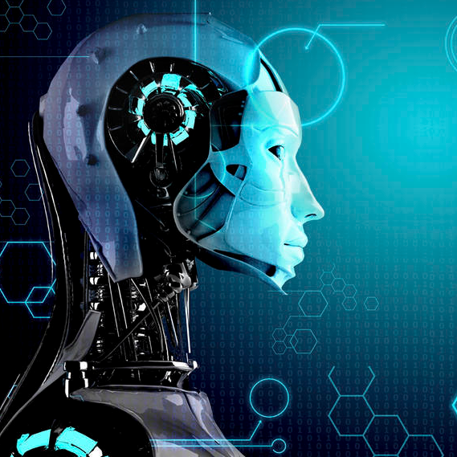

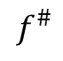
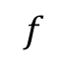
Goal of AI
$$f$$
$$f^{\#}$$
Obtain a $f^{\#}$ as close as possible to $f$
Photo licensed under CC BY-ND

Slide 4
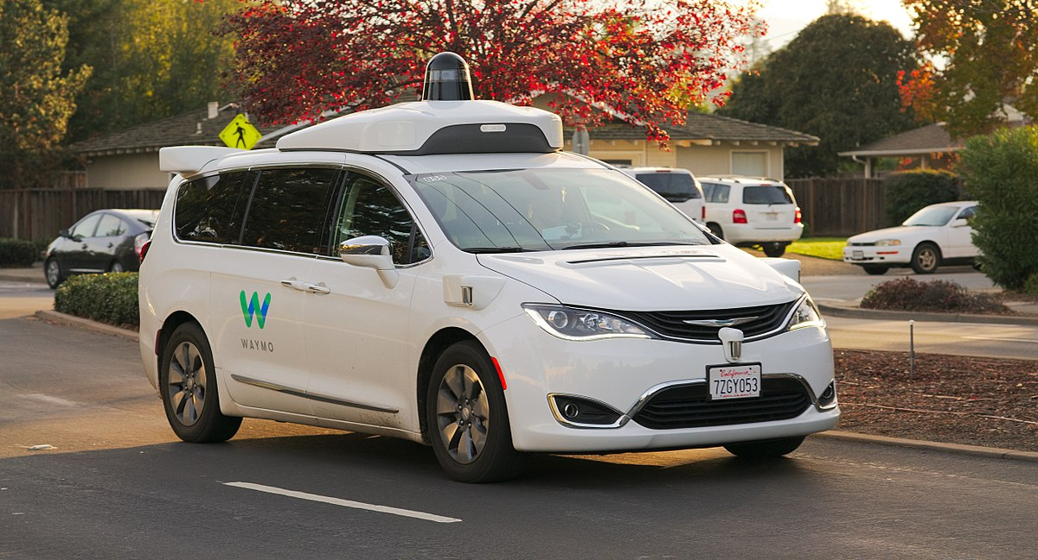

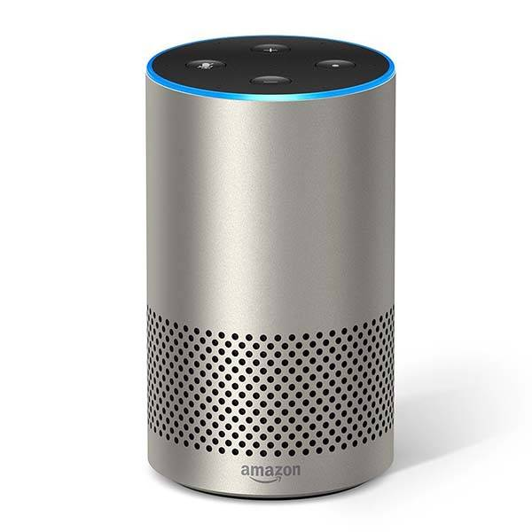


Deep learning revolution
Autonomous driving
Machine translation
Speech recognition
AI for health
Gaming

Slide 5
State-of-the-art models are fragile
White box attacks:
FGSM: [ICLR’15]
JSMA: [Euro S&P’16]
C&W: [S&P’17]
PGD: [ICLR’18]
……
Black box attacks:
LSA [CVPRW’17]
BA [ICLR’18]
HSJA [S&P’20]
QEBA [CVPR’20]
……
Most of the existing attacks are not reproducible in the real-world

Slide 6
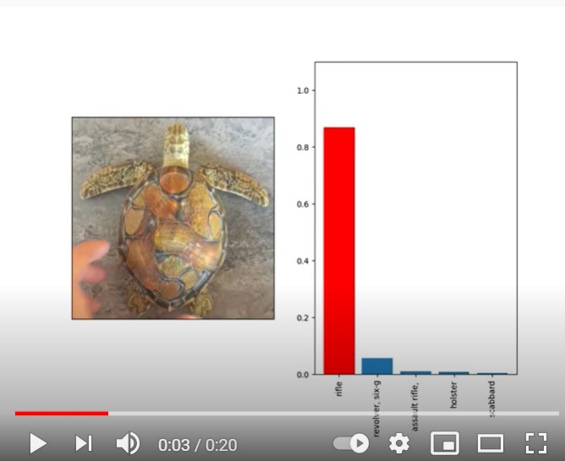
Real-world adversarial attacks on image classifiers [Athalye et al., ICML’18]
https://www.youtube.com/watch?v=YXy6oX1iNoA&feature=youtu.be&ab_channel=SynthesizingRobustAdversarialExamples

Slide 7
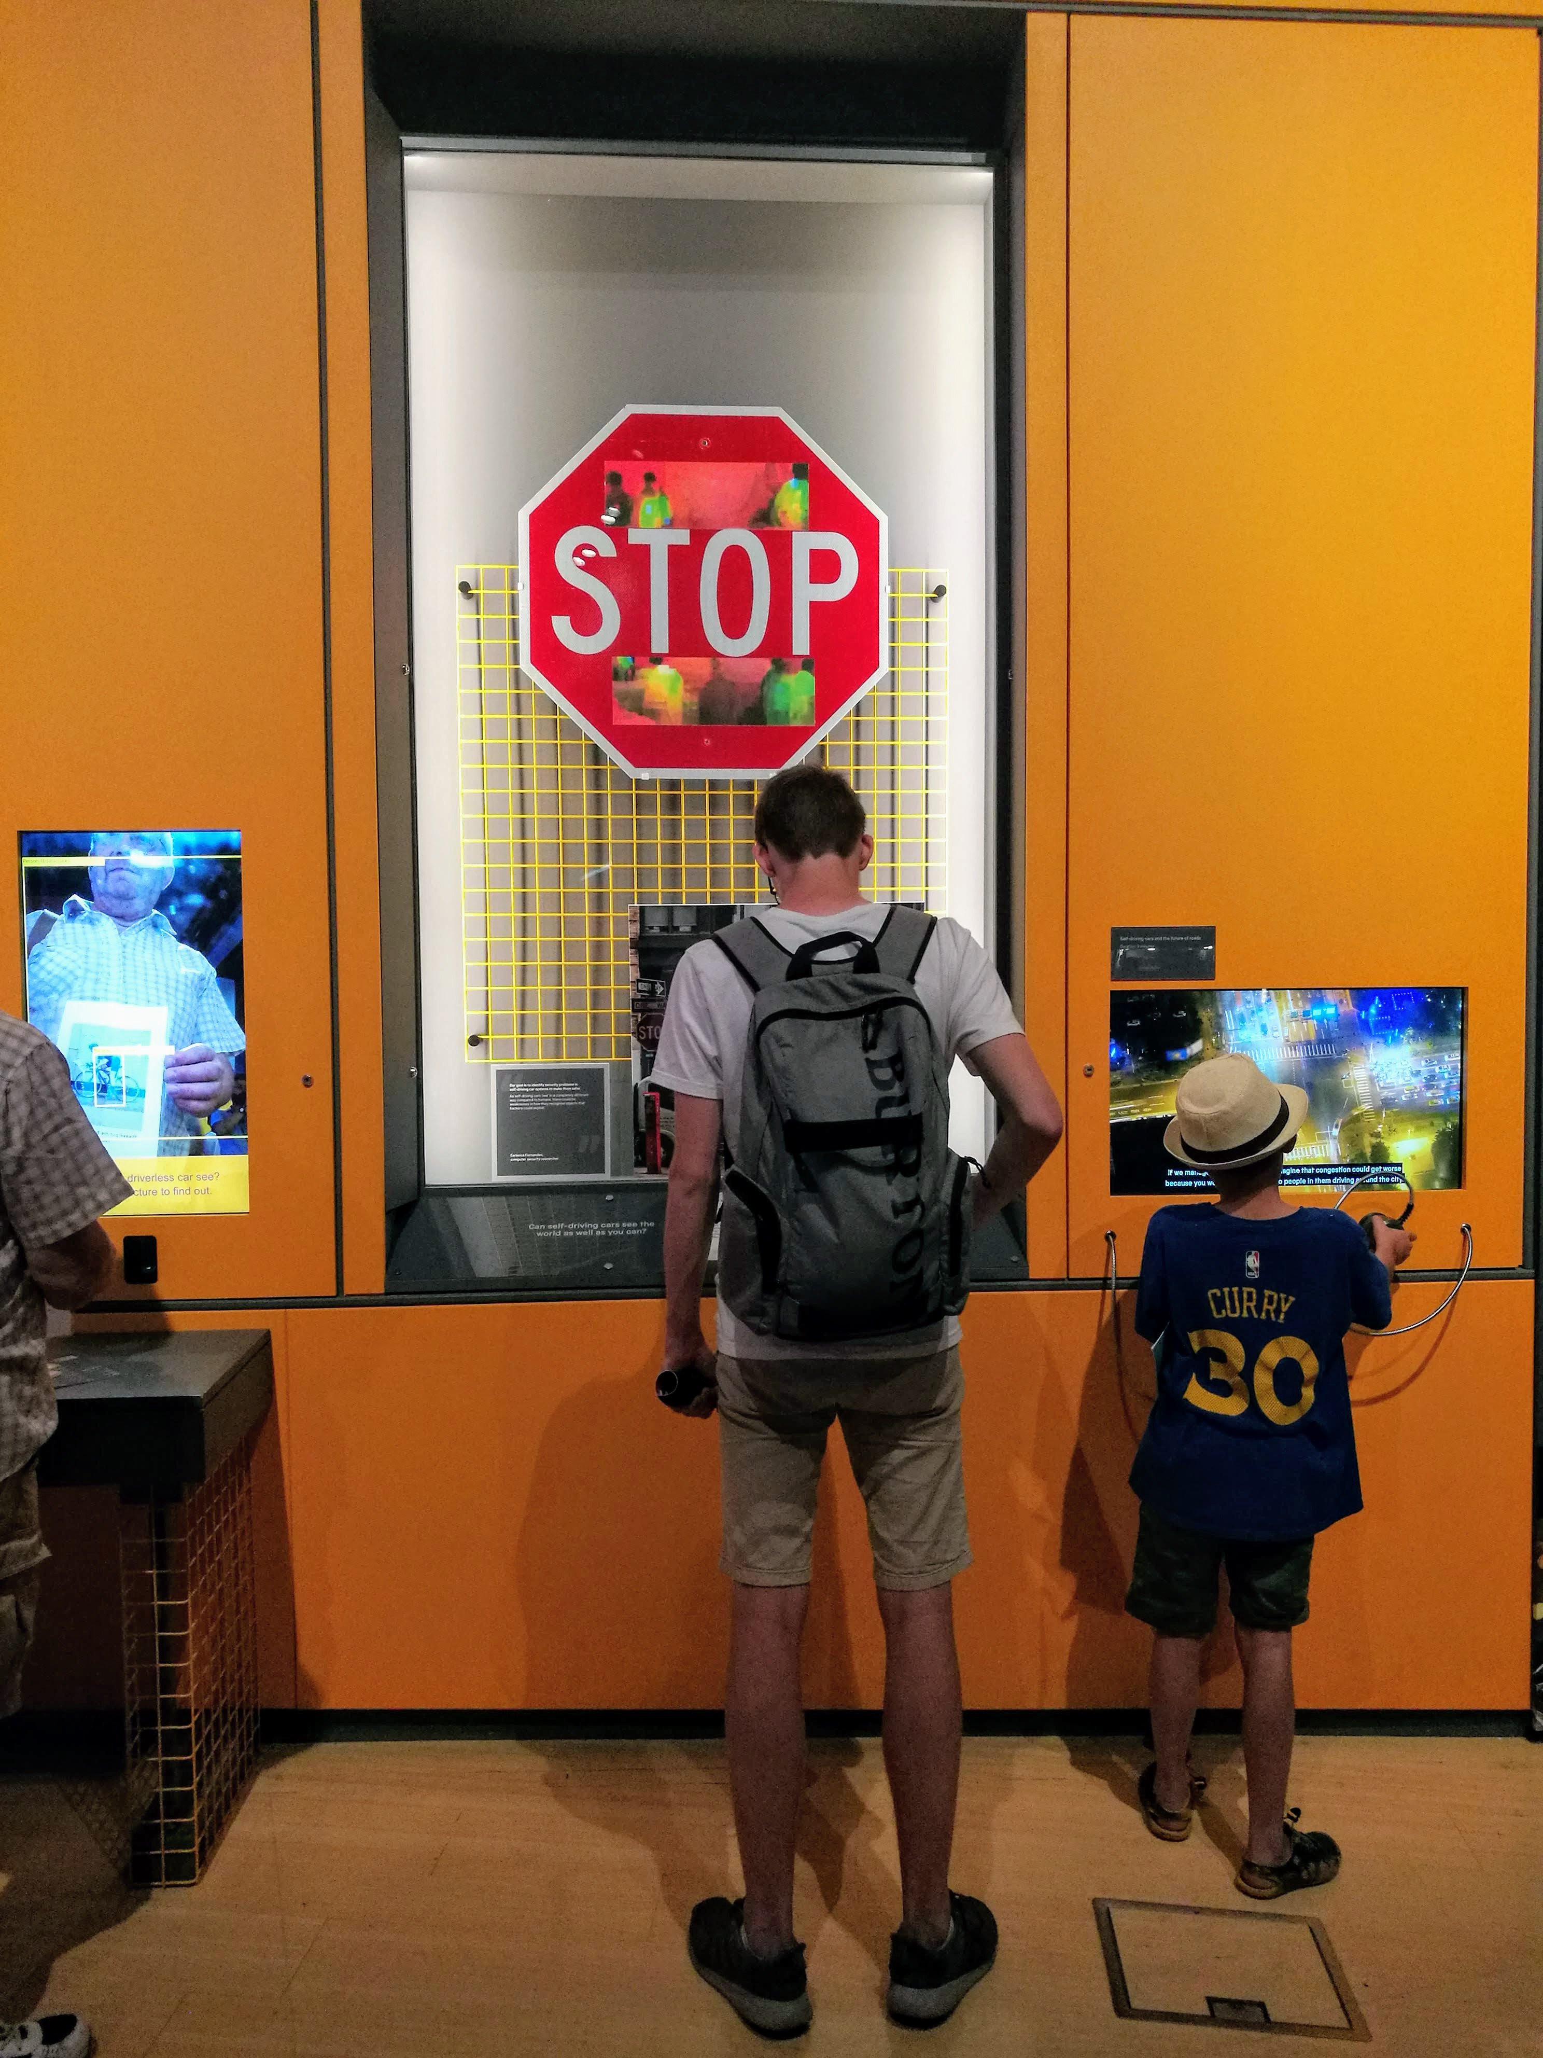
Real-world adversarial attacks on image classifiers [Eykholt et al., CVPR’18]
https://www.sciencemuseum.org.uk/see-and-do/driverless-who-is-in-control

Slide 8
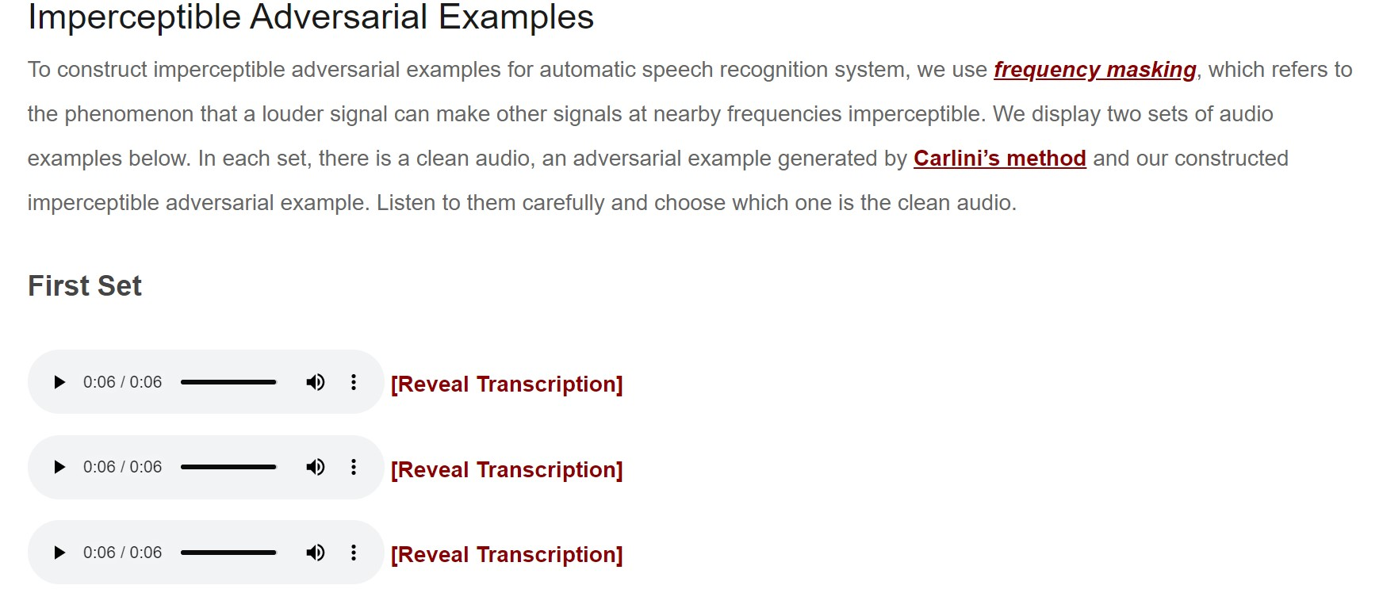
Real-world adversarial attacks on audio classifiers [Qin et al., ICML’19]
http://cseweb.ucsd.edu/~yaq007/imperceptible-robust-adv.html

Slide 9
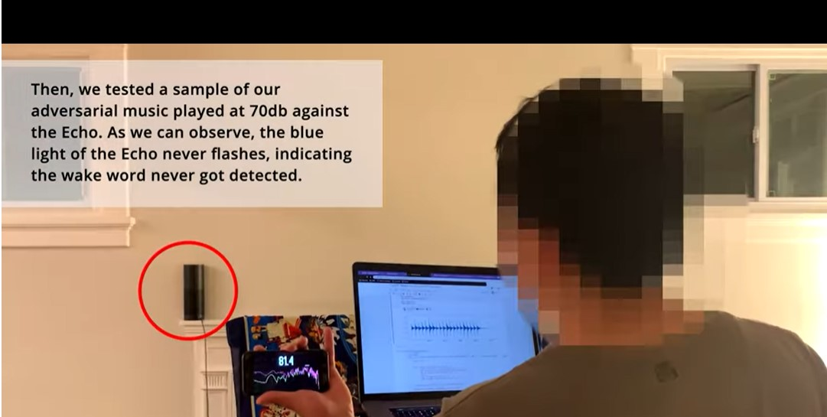
Real-world adversarial attacks on audio classifiers [Li et al., NeurIPS’19]
https://www.youtube.com/watch?v=r4XXGDVs0f8&feature=emb_logo&ab_channel=Billyli

Slide 10
The need for formal verification
Plethora of work on designing attacks and empirical defenses, however these have no formal guarantees
Our goal: provide formal guarantees on safety and robustness of deep learning models

Slide 11



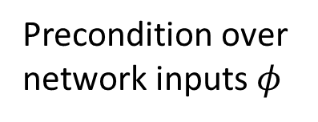
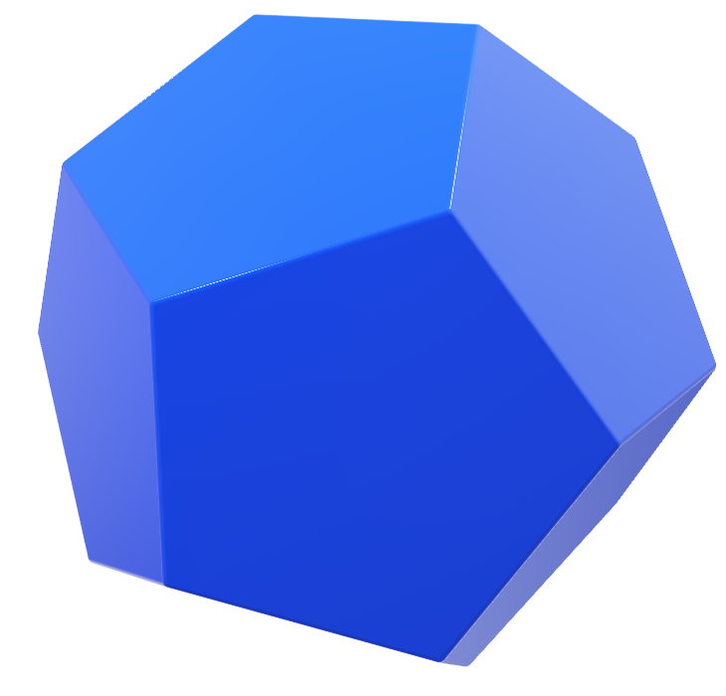
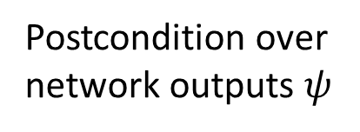
Neural network certification: problem statement
$$f(φ)$$
Precondition over
network inputs $φ$
Network $f$
Postcondition over
network outputs $ψ$

Slide 12

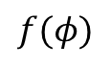

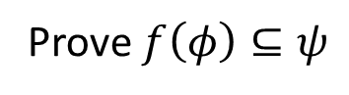

Neural network certification: problem statement
$$f(φ)$$
$$f(φ)$$
Precondition over
network inputs $φ$
Network $f$
Prove $f\left(φ\right)⊆ψ$

Slide 13

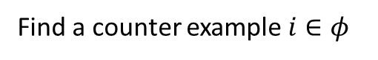
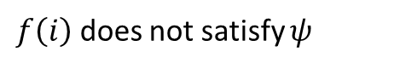
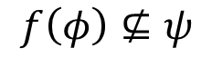
Neural network certification: problem statement
Find a counter example $i∈φ$
$f\left(i\right)$ does not satisfy $ψ$
$$f(φ)$$
$$f(φ)$$
Precondition over
network inputs $φ$
Network $f$
$$f\left(φ\right)⊈ψ$$
Neural network certification is NP-hard [Katz et al. CAV’17]

Slide 14
Dimensions: Certified artificial intelligence
Applications
Vision NLP Finance Robotics Aviation
Speech Code models Health care Gaming Manufacturing
Specifications
Intensity based Geometric Patch based Sensor values Word substitution
Robustness Safety Stability Fairness Temporal
Architectures
FCN CNN Residual LSTM Transformers VAE GAN DQN
ReLU Sigmoid Tanh Maxpool ELU Softplus Softsign
MILP SMT Lipschitz constant Duality Convex relaxations MILP + Relaxations
Methods
Deterministic Probabilistic
Guarantees
ERAN certification framework https://github.com/eth-sri/eran
Long term goal: Generalized framework for verifying arbitrary models and properties
Notes:
Classifiers or regressors?

Slide 15
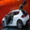




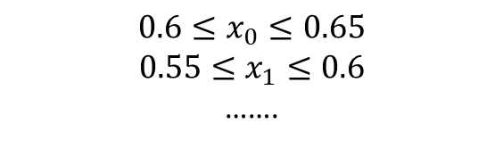

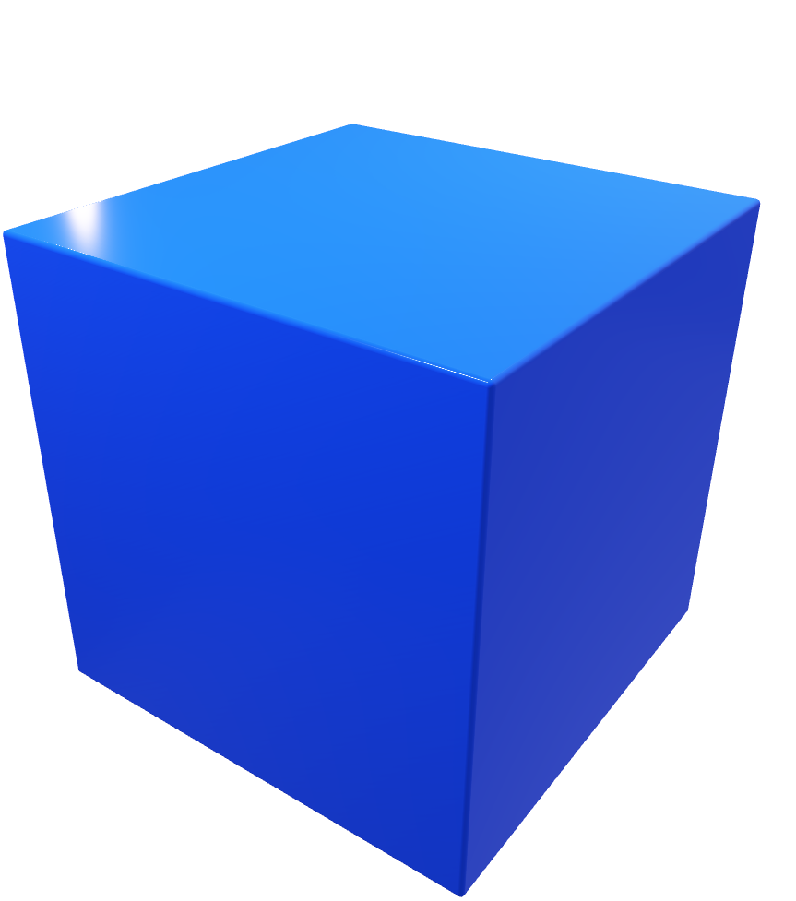
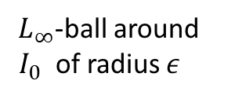

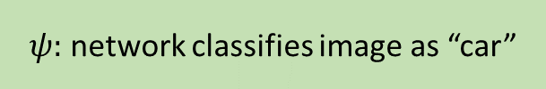
Robustness against intensity changes
$$0.6≤x_{0}≤0.65$$
$$0.55≤x_{1}≤0.6$$
…….
$$I_{0}$$
$L_{∞}$-ball around
$I_{0}$ of radius $ε$
$ψ:$ network classifies image as “car”
Network correctly classifies $I_{0}$ as “car”
$φ$ with $ε=8/255$
$φ$ contains ${17}^{3072}$ images which makes enumeration infeasible

Slide 16



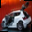


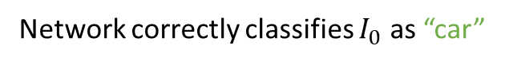
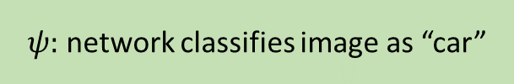
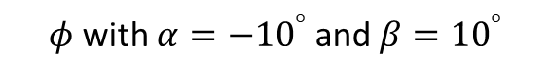


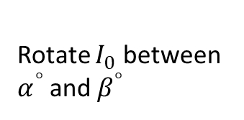
Robustness against geometric transformations
$$x_{0}=f_{0}(α,β)$$
$$x_{1}=f_{1}(α,β)$$
…….
$$I_{0}$$
Rotate $I_{0}$ between $α^{°}$ and$β^{°}$
$ψ:$ network classifies image as “car”
Network correctly classifies $I_{0}$ as “car”
$φ$ with $α={−10}^{°}$ and $β={10}^{°}$

Slide 17
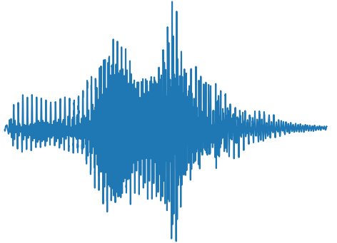
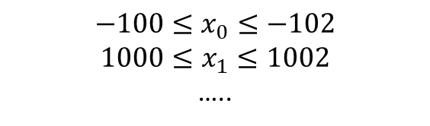
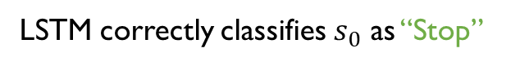

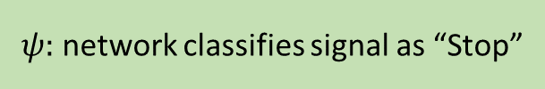
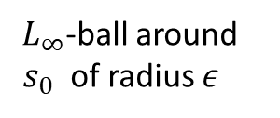


Robustness against sound intensity changes
$$−100≤x_{0}≤−102$$
$$1000≤x_{1}≤1002$$
…..
$$s_{0}$$
$L_{∞}$-ball around
$s_{0}$ of radius $ε$
$ψ:$ network classifies signal as “Stop”
$φ$ with $ε=−80 dB$
LSTM correctly classifies $s_{0}$ as “Stop”
$φ$ with $ε=−90 dB$
Notes:
No animation for slide numbers

Slide 18
Dimensions: Certified artificial intelligence
Applications
Vision NLP Finance Robotics Aviation
Speech Code Models Health care Gaming Manufacturing
Specifications
Intensity based Geometric Patch based Sensor values Word substitution
Robustness Safety Stability Fairness Temporal
Architectures
FCN CNN Residual LSTM Transformers VAE GAN DQN
ReLU Sigmoid Tanh Maxpool ELU Softplus Softsign
MILP SMT Lipschitz constant Duality Convex relaxations MILP + Relaxations
Methods
Deterministic Probabilistic
Guarantees
ERAN certification framework https://github.com/eth-sri/eran

Slide 19
Current state-of-the-art approaches to certification
Exact methods:
Scalability issues
SMT: Reluplex [CAV’17]
MILP: MIPVerify [ICLR’19]
Splitting: Neurify [NeurIPS’18]
……
Approximate methods:
Trade precision for scalability
HBox [ICML’18]
SDP [ICLR’18]
Wong et al. [ICML’18]
FastLin [ICML’18]
CROWN [NeurIPS’18]
……
Key Challenge: scalable and precise automated verifier
We will next discuss both approximate and exact methods

Slide 20




Approximations based on abstract interpretation
An elegant mathematical framework for over-approximating infinite concrete behaviors with finite representation
Abstraction $g(φ)$
Patrick and Radhia Cousot
Inventors
Output: Prove that $f\left(φ\right)⊆ψ$ holds
or return a counter example

Slide 21


Abstract interpretation
An elegant mathematical framework for over-approximating infinite concrete behaviors with finite representation
Approximate
Abstraction $g(φ)$
Concrete
$$f(φ)$$
Patrick and Radhia Cousot
Inventors
Output: Prove $g\left(φ\right)⊆ψ$ with $f\left(φ\right)⊆g(φ)$, there might be false positives
Tradeoff between the precision and the scalability of an abstraction

Slide 22








Approximate certification: high level idea
...
Certification
$$φ$$
Over-approximations of the layer outputs
$g$($φ)$
All possible outputs
Attacker region $L_{∞}$ ball with $ε=8/255$:
$x_{0}=[0.588,0.65$]
$x_{1}=$ [0.545,0.608]
$x_{2}=$ [0.533,0.596]
…
$x_{3071}=$[0.4,0.463]
Output constraints
$$o_{0}=0$$
$$o_{1}=2.60+0.015η_{0}+0.023η_{1}+5.18{1η}_{2}+…$$
$$o_{2}=4.63−0.005η_{0}−0.006η_{1}+0.023η_{2}+…$$
…
$$o_{9}=0.12−0.12{5η}_{0}+0.102η_{1}+3.012η_{2}+…$$
$$∀i. η_{i}∈[0,1]$$

Slide 23


























Verifying robustness: toy example
We have 2 pixels ($x_{1}$, $x_{2}$) as input ranging over [0, 0.3] and [0.1, 0.4]
$$0$$
$$0.5$$
$$[0,0.3]$$
$$1$$
$$max⁡(0,x_{3})$$
$$1$$
$$x_{1}$$
$$x_{3}$$
$$x_{5}$$
$$x_{7}$$
$$1$$
$$1$$
$$1$$
$$1$$
$$x_{2}$$
$$x_{4}$$
$$x_{6}$$
$$x_{8}$$
$$[0.1,0.4]$$
$$−1$$
$$max⁡(0,x_{4})$$
$$−1$$
$$0$$
$$−0.5$$
We want to prove that for all inputs in the given range, $x_{7}>x_{8}$ holds.

Slide 24



Approximate method I: Box
$$x_{2}$$
$$x_{1}$$
Box: $l_{i}≤x_{i}≤u_{i}$

Slide 25






Box Transformers Needed for Handling ReLU Neural Networks
$$\left[a,b\right] +^{\#}[c,d]=[a+c, b+d]$$
Addition transformer
$$−^{\#}[a,b]=[−b, −a]$$
Negation transformer
$${ReLU}^{\#}[a,b]=[ReLU\left(a\right), ReLU(b)]$$
ReLU transformer
$$λ^{\#}[a,b]=[λ ∗a, λ ∗b]$$
Multiplication by a constant $λ>0$
Here, $a,b∈R^{m}$where $∀i. a_{i}≤b_{i}$
$ReLU\left(x\right)=max(0,x)$
$\#$ denotes the effect of the operation on the box

Slide 26








Box transformer is not exact!
We have 2 pixels ($x_{1}$, $x_{2}$) as input ranging over [0, 0.3] and [0.1, 0.4]
$$[0,0.3]$$
$$[0.1,0.7]$$
$$0$$
Bounds using Box:
$$[0,0.3]$$
$$1$$
$$0.1≤x_{3}≤0.7$$
$$x_{1}$$
$$x_{3}$$
$$1$$
$$−0.4≤x_{4}≤0.2$$
Exact bounds would be:
$$1$$
$$x_{3}=x_{1}+x_{2}$$
$$x_{4}=x_{1}−x_{2}$$
$$0≤x_{1}≤0.3$$
$$0.1≤x_{2}≤0.4$$
$$x_{2}$$
$$x_{4}$$
$$[0.1,0.4]$$
$$−1$$
$$0$$
$$[0.1,0.4]$$
$$[−0.4,0.2]$$
This point is in the Box,
but is infeasible:
$$x_{3}=0.7 x_{4}=−0.4$$
Notes:
0.7 = x1+x2
-0.4 =x1-x2
X1 = 0.7 – x2
-0.4 = 0.7-x2-x2
-0.4 = 0.7-2x2
2x2 = 1.1
X2 = 0.55

Slide 27
Key Point
The Box transformer for the affine and ReLU computation may not be exact! as it ignores relationship between neurons. Nonetheless, it may be enough to verify the property of interest.
Lets see this next.

Slide 28







Box succeeds in verifying robustness
We have 2 pixels ($x_{1}$, $x_{2}$) as input ranging over [0, 0.3] and [0.1, 0.4]
$$[0,0.3]$$
$$[0.1,0.7]$$
$$[0.1,0.7]$$
$$[0.6,1.4]$$
$$0$$
$$0.5$$
$$[0,0.3]$$
$$1$$
$$max⁡(0,x_{3})$$
$$1$$
$$x_{1}$$
$$x_{3}$$
$$x_{5}$$
$$x_{7}$$
$$1$$
$$1$$
$$1$$
$$1$$
$$x_{2}$$
$$x_{4}$$
$$x_{6}$$
$$x_{8}$$
$$[0.1,0.4]$$
$$−1$$
$$max⁡(0,x_{4})$$
$$−1$$
$$0$$
$$−0.5$$
$$[0.1,0.4]$$
$$[−0.4,0.2]$$
$$[0,0.2]$$
$$[−0.6,0.2]$$
Using Box, we succeed in proving that $x_{7}>x_{8}$ holds for all inputs. This is because [0.6,1.4] > [-0.6, 0.2].

Slide 29































Box fails in verifying robustness
Let us slightly increase the range of the input pixels to [0, 0.6] and [0.1, 0.7]
$$[0,0.6]$$
$$[0.1,1.3]$$
$$[0.1,1.3]$$
$$[0.6,2.3]$$
$$0$$
$$0.5$$
$$[0,0.6]$$
$$1$$
$$max⁡(0,x_{3})$$
$$1$$
$$x_{1}$$
$$x_{3}$$
$$x_{5}$$
$$x_{7}$$
$$1$$
$$1$$
$$1$$
$$1$$
$$x_{2}$$
$$x_{4}$$
$$x_{6}$$
$$x_{8}$$
$$[0.1,0.7]$$
$$−1$$
$$max⁡(0,x_{4})$$
$$−1$$
$$0$$
$$−0.5$$
$$[0.1,0.7]$$
$$[−0.7,0.5]$$
$$[0,0.5]$$
$$[−0.9,0.8]$$
Box fails to prove that $x_{7}>x_{8}$ holds, even though property actually holds. This is because [0.6,2.3] is not > [-0.9, 0.8].

Slide 30
Exact method: MILP
Let us incorporate MILP (Mixed Integer Linear Program) solvers in order to verify robustness. For ReLU networks, MILP is exact. However, this comes at the cost that MILP is at least NP-complete (cannot be solved in polynomial time in any known manner) due to underlying linear programs. Further, there is an additional exponential factor due to splitting.
We will first define the standard MILP problem. Then, we will use the Box bounds to constrain MILP. So, Box will help MILP be faster by doing less work (MILP still remains exact).
Notes:
Cannot be solved in polynomial time in any known way

Slide 31







MILP Generic Problem Definition
$$min c_{1}x_{1}+c_{2}x_{2}+…+c_{n}x_{n}$$
objective
$$a_{11}x_{1}+…+a_{1n}x_{n}≤b_{1}$$
….
$$a_{m1}x_{1}+…+a_{mn}x_{n}≤b_{m}$$
constraints
$${l_{i}≤x}_{i}≤u_{i} 1≤i≤n$$
bounds on continuous $x_{i}$
$$x_{j}∈Z$$
some $x_{j}$ are integer
$c_{i}, a_{ij}, b_{i} ∈R$ and $l, u∈R^{n}$
some $x_{j}$‘s can be integers (or even binary), hence Mixed-Integer problem
state-of-the-art solvers (e.g., Gurobi) require bounds on $x_{i}^{}$’s

Slide 32

MILP encoding of Neural Network
To encode the network as a MILP instance, we need to:
Encode the affine layer
Encode the ReLU layer
Encode the pre-condition $φ$
Encode the post-condition $ψ$

Slide 33


Encode Affine layer as MILP
This is direct as it is just a linear constraint
where $W$ are the weights and $b$ is the bias
$$y= Wx+b$$
(note: convolution is also an affine transformation, can be encoded directly)

Slide 34









Encode ReLU layer as MILP
ReLU definition is:
$$y= ReLU\left(x\right)=max(0,x)$$
MILP ReLU encoding is:
$$y≤x −l ∗\left(1−a\right)$$
$$y≥x$$
$$y≤u∗a$$
$$y≥0$$
$$a∈\{0,1\}$$
Here, is a binary integer variable
$a=0$ implies that $l≤x≤0 and$ $y=0$
$a=1$ implies that $0≤x≤u and$ $y=x$
This assumes we have computed lower $l$ and upper $u$bounds for each neuron (e.g., by using Box beforehand).

Slide 35








Encode Pre-condition $φ$as MILP
Lets take $φ$= L$∞$ball around $x$as an example:
L$∞$ball:
Ball($x$)$ε$ = {$x^{′}$ | || $x$ – $x′$ ||$∞$ < $ε$ }
Input $x$
$$φ$$
MILP encoding:
That is, we will introduce lower and upper bound constraints for each input neuron $x_{i}^{′}$
$$x_{i}−ε≤ x_{i}^{′}≤x_{i}+ε$$

Slide 36





Encode Post-condition $ψ$as MILP
Lets take $ψ$ on our example network
We want to prove this. Hence, this must be forming our MILP objective
$$ψ=x_{7}>x_{8}$$
MILP encoding:
$$\min{ x_{7}−x_{8}}$$
If the minimum value is $>0$, then verification succeeds, if not, verification fails.

Slide 37











Generic vs. Instantiated MILP
Generic MILP problem
Our MILP instance
$$min c_{1}x_{1}+c_{2}x_{2}+…+c_{n}x_{n}$$
$${\min{ x_{7}−x}}_{8}$$
$$a_{11}x_{1}+…+a_{1n}x_{n}≤b_{1}$$
….
$$a_{m1}x_{1}+…+a_{mn}x_{n}≤b_{m}$$
Plug in the affine and ReLU MILP encodings as defined
pre-computed Box bounds
on all neurons in each layer $p$
$$l_{i}≤ x_{i}^{p}≤u_{i}$$
$${l_{i}≤x}_{i}≤u_{i} 1≤i≤n$$
$φ:$bounds on
input neurons
$$x_{i}−ε≤ x_{i}^{′}≤x_{i}+ε$$
These are the $a∈\left\{0,1\right\}$vars
from the ReLU encoding
$$x_{j}∈Z$$
$$a_{j}∈\{0,1\}$$

Slide 38
































Reminder: these are the bounds with Box
$$[0,0.6]$$
$$[0.1,1.3]$$
$$[0.1,1.3]$$
$$[0.6,2.3]$$
$$0$$
$$0.5$$
$$[0,0.6]$$
$$1$$
$$max⁡(0,x_{3})$$
$$1$$
$$x_{1}$$
$$x_{3}$$
$$x_{5}$$
$$x_{7}$$
$$1$$
$$1$$
$$1$$
$$1$$
$$x_{2}$$
$$x_{4}$$
$$x_{6}$$
$$x_{8}$$
$$[0.1,0.7]$$
$$−1$$
$$max⁡(0,x_{4})$$
$$−1$$
$$0$$
$$−0.5$$
$$[0.1,0.7]$$
$$[−0.7,0.5]$$
$$[0,0.5]$$
$$[−0.9,0.8]$$

Slide 39









MILP Instance for this network
$$\min{ x_{7}−x_{8}}$$
Affine
ReLU: $x_{5}=max⁡(0,x_{3})$
ReLU: $x_{6}=max⁡(0,x_{4})$
$$x_{3}=x_{1}+x_{2}$$
$$x_{4}=x_{1}−x_{2}$$
$$x_{7}=x_{5}+x_{6}+0.5$$
$$x_{8}=x_{5}−x_{6}−0.5$$
$$x_{5}≤x_{3} −0.1 ∗\left(1−a_{5}\right)$$
$$x_{5}≥x_{3 }$$
$$x_{5}≤1.3∗a_{5}$$
$$x_{5}≥0$$
$$x_{6}≤x_{4}+0.7 ∗\left(1−a_{6}\right)$$
$$x_{6}≥x_{4}$$
$$x_{6}≤0.5∗a_{6}$$
$$x_{6}≥0$$
Input bounds
Pre-computed Box bounds
Binary integer variables
$$0≤x_{1}≤0.6$$
$$0.1≤x_{2}≤0.7$$
$$0.1≤x_{3}≤1.3$$
$$−0.7≤x_{4}≤0.5$$
$$0.1≤x_{5}≤1.3$$
$$0≤x_{6}≤0.5$$
$$a_{5}, a_{6}∈\left\{0,1\right\}$$
Solving this MILP instance will lead to proving the property

Slide 40
Lets solve MILP to see why Box helps (Note: MILP solvers employ elaborate algorithms, the idea here is to show how Box can help even state-of-the-art MILP solvers)

Slide 41



Case $a_{5}=0$
$$\min{ x_{7}−x_{8}}$$
Affine
ReLU: $x_{5}=max⁡(0,x_{3})$
ReLU: $x_{6}=max⁡(0,x_{4})$
$$x_{3}=x_{1}+x_{2}$$
$$x_{4}=x_{1}−x_{2}$$
$$x_{7}=x_{5}+x_{6}+0.5$$
$$x_{8}=x_{5}−x_{6}−0.5$$
$$x_{5}≤x_{3} −0.1$$
$$x_{5}≥x_{3 }$$
$$…$$
$$x_{6}≤x_{4}+0.7 ∗\left(1−a_{6}\right)$$
$$x_{6}≥x_{4}$$
$$x_{6}≤0.5∗a_{6}$$
$$x_{6}≥0$$
Pre-computed Box bounds
This is an infeasible LP instance so MILP does not have to consider it .
Here, Box bounds helped MILP in not exploring further values for $a_{6}\text{. }\text{So} \text{it} \text{saved} \text{generating} \text{two} \text{cases} \text{for}a_{6}$.
$$0.1≤x_{3}≤1.3$$
$$−0.7≤x_{4}≤0.5$$
$$0.1≤x_{5}≤1.3$$
$$0≤x_{6}≤0.5$$

Slide 42



In practice, we directly generate this MILP
$$\min{ x_{7}−x_{8}}$$
Affine
ReLU: $x_{5}=max⁡(0,x_{3})$
ReLU: $x_{6}=max⁡(0,x_{4})$
$$x_{3}=x_{1}+x_{2}$$
$$x_{4}=x_{1}−x_{2}$$
$$x_{7}=x_{5}+x_{6}+0.5$$
$$x_{8}=x_{5}−x_{6}−0.5$$
$$x_{5}=x_{3}$$
$${0.1≤x}_{3}≤1.3$$
$$x_{6}≤x_{4}+0.7 ∗\left(1−a_{6}\right)$$
$$x_{6}≥x_{4}$$
$$x_{6}≤0.5∗a_{6}$$
$$x_{6}≥0$$
can prove
$x_{3}$ is positive using Box bounds
Input bounds
Pre-computed Box bounds
Binary integer variable
$$0≤x_{1}≤0.6$$
$$0.1≤x_{2}≤0.7$$
$$0.1≤x_{3}≤1.3$$
$$−0.7≤x_{4}≤0.5$$
$$0.1≤x_{5}≤1.3$$
$$0≤x_{6}≤0.5$$
$$a_{6}∈\left\{0,1\right\}$$

Slide 43





Case $a_{6}=0$
$$\min{ x_{7}−x_{8}}$$
Affine
ReLU: $x_{5}=max⁡(0,x_{3})$
ReLU: $x_{6}=max⁡(0,x_{4})$
$$x_{3}=x_{1}+x_{2}$$
$$x_{4}=x_{1}−x_{2}$$
$$x_{7}=x_{5}+x_{6}+0.5$$
$$x_{8}=x_{5}−x_{6}−0.5$$
$$x_{5}=x_{3}$$
$${0.1≤x}_{5}≤1.3$$
$${−0.7≤ x}_{4} ≤0$$
$$x_{6}=0$$
simplifying
Input bounds
Pre-computed Box bounds
$$x_{7}−x_{8}=2∗x_{6}+1 \\ x_{7}−x_{8}=1$$
$$0≤x_{1}≤0.6$$
$$0.1≤x_{2}≤0.7$$
$$0.1≤x_{3}≤1.3$$
$$−0.7≤x_{4}≤0.5$$
$$0.1≤x_{5}≤1.3$$
$$0≤x_{6}≤0.5$$
Here, we proved, subject to the constraints, that the minimum is always 1, hence property holds.
Note: cannot just use the bounds for $x_{5}$and $x_{6}$
for computing $x_{7}−x_{8}$ : this will fail! Good to try.

Slide 44



Case $a_{6}=1$
$$\min{ x_{7}−x_{8}}$$
Affine
ReLU: $x_{5}=max⁡(0,x_{3})$
ReLU: $x_{6}=max⁡(0,x_{4})$
$$x_{3}=x_{1}+x_{2}$$
$$x_{4}=x_{1}−x_{2}$$
$$x_{7}=x_{5}+x_{6}+0.5$$
$$x_{8}=x_{5}−x_{6}−0.5$$
$$x_{5}=x_{3}$$
$${0.1≤x}_{5}≤1.3$$
$$x_{6}=x_{4}$$
$$0≤x_{4}≤0.5$$
simplifying
Input bounds
Pre-computed Box bounds
$$x_{7}−x_{8}=2∗x_{6}+1$$
$$1≤ x_{7}−x_{8}≤2$$
$$\min\left(x_{7}−x_{8}\right)=1$$
$$0≤x_{1}≤0.6$$
$$0.1≤x_{2}≤0.7$$
$$0.1≤x_{3}≤1.3$$
$$−0.7≤x_{4}≤0.5$$
$$0.1≤x_{5}≤1.3$$
$$0≤x_{6}≤0.5$$
Here, we proved the property again

